Slide 1
Basic Peripherals and Their Interfacing with 8086/88

Slide 2
Semiconductor Memory Interfacing
Semiconductor memories are of two types,
RAM (Random Access Memory) and
ROM (Read Only Memory)
Static RAM Interfacing:
The semiconductor RAMs are broadly two types – static RAM and dynamic RAM.
The semiconductor memories are organized as two dimensional arrays of memory locations.
For example, 4K X 8 or 4K byte memory contains 4096 locations, where each location contains 8 – bit data and only one of the 4096 locations can be selected at a time.
Once a location is selected all the bits in are accessible using a group conductors called data bus.
Obviously, for addressing 4 k bytes of memory, twelve address lines are required. in general, to address a memory location out of N memory locations, we will required at least n bit address, i.e. n address lines where n = Log N.
Thus if the micro processor has n address lines then it is able to address at the most N locations of memory, where 2^n = N. however,
If out of N locations only P memory locations are to be interfaced, then the least significant p address lines out of the available n lines can be directly connected from the microprocessor to the memory chip
while the remaining (n-p) i.e Higher order address lines may be used for address decoding

Slide 3
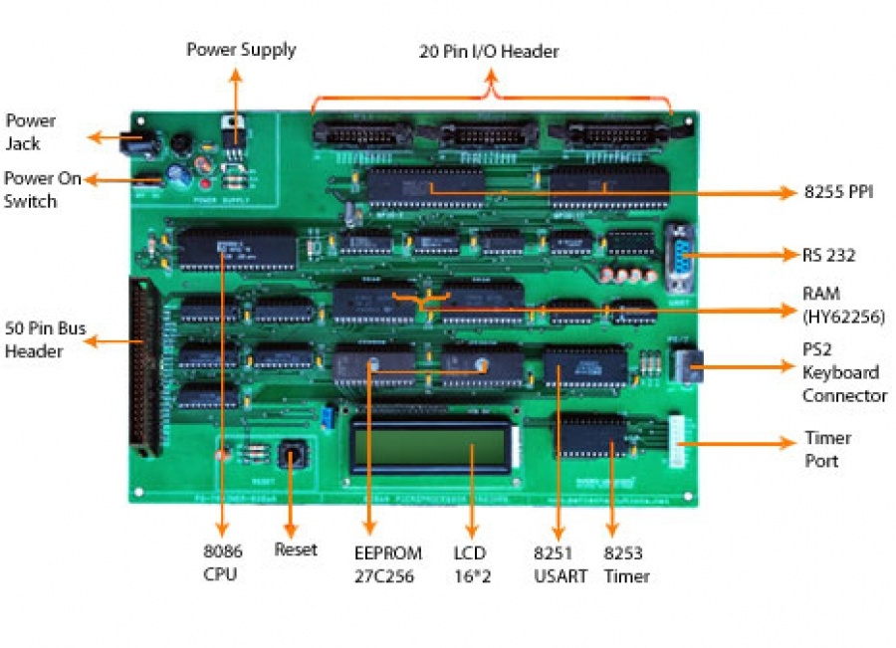

Slide 4
Semiconductor Memory Interfacing
The general procedure of static memory interfacing with 8086 is briefly described as follows
Arrange the available memory chips so as to obtain 16 bit data bus width.
The upper 8 bit bank is called ‘odd address memory bank’ and the lower 8 bit bank is called ‘even address memory bank’.
Connect available memory address lines of memory chips with those of the microprocessor and also connect the 16 bit data bus of the memory bank with that of the microprocessor 8086.
The remaining address lines of the microprocessor, BHE (bar) and A0 are used for decoding the required chip select signals for the odd and even memory banks. The CS bar memory is derived from the O/P of the decoding circuit.

Slide 5
Semiconductor Memory Interfacing
As a good and efficient interfacing practice, the address map of the system should be continuous as far as possible, i.e. there should be no windows in the map and no fold back space should be allowed.
A memory location should have a single address corresponding to it, i.e. absolute decoding should be preferred, and minimum hardware should be used for decoding.

Slide 6
Semiconductor Memory Interfacing
Problem: Interface two 4K X 8 EPROMS and two 4K X 8 RAM chips with 8086. select suitable maps.
Solution:
We know that, after reset, the IP and CS are initialized to from address FFFF0H.
Hence, this address must lie in the EPROM.
The address of RAM may be selected any where in the 1MB address space of 8086, but we will select the RAM address such that the address map of the system is continuous as shown.
Total 8K bytes of EPROM need 13 address lines A0 – A12.
Address lines A13 – A19 are used for decoding to generate the chip select.
The BHE bar signal goes low when a transfer is at odd address or higher byte of data is to be accessed.
Let us assume that the latched address, BHE (bar) and de-multiplexed data lines are readily for interfacing.
The two 4K X 8 chips of RAM and ROM are arranged in parallel to obtain 16 bit data bus width.
If A0 is 0, i.e. the address is even and is in RAM, then the lower RAM chip is selected indicating 8 bit transfer at even address.
If A0 is 1, i.e. the address is odd and is in RAM, the BHE bar goes low; the upper RAM chip is selected, further indicating that the 8 bit transfer is at an odd address.

Slide 7
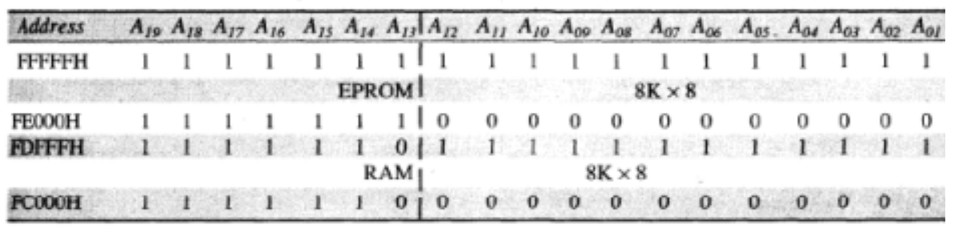
Semiconductor Memory Interfacing
Memory Map Table

Slide 8
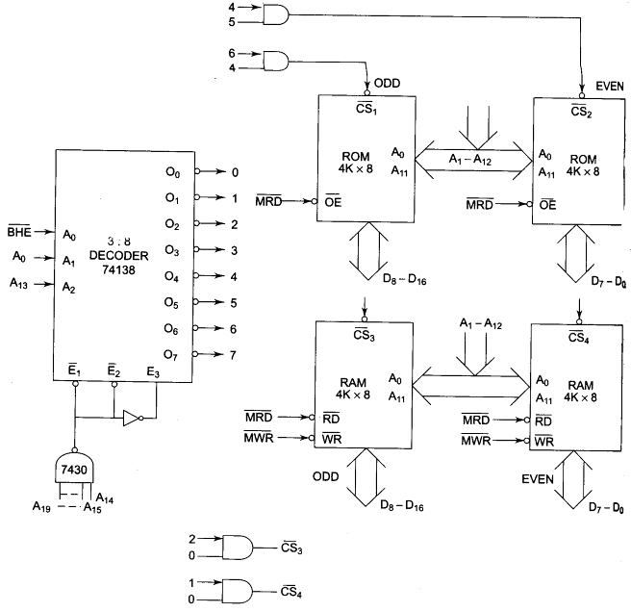
Semiconductor Memory Interfacing

Slide 9
Semiconductor Memory Interfacing
Problem: Design an interface between 8086 CPU and two chips of 16Kx8 EPROM and two chips of 32 K X 8 RAM. Select the starting address of EPROM suitably. The RAM address must start at 00000H.
Solution:
The last address in the map of 8086 is FFFFFH. After resetting, the processor starts from FFFF0H. Hence this address must lie in the address range of EPROM.
It is better not to use a decoder to implement the above map because it is not continuous, i.e. there is some unused address space between the last RAM address (0FFFFH) and the first EPROM address (F8000H).
Let us select a variable C for memory address pulse, i.e. output of 6 input NAND gate. BHE (bar) is abbreviated as B.
C2 = A0;
C1 = BHE (bar);
CS1 (bar); = C + C1 = C + BHE (bar); and CS2 (bar); = C + C2 = C + A0
Similarly CS3 and CS4 can be obtained.

Slide 10
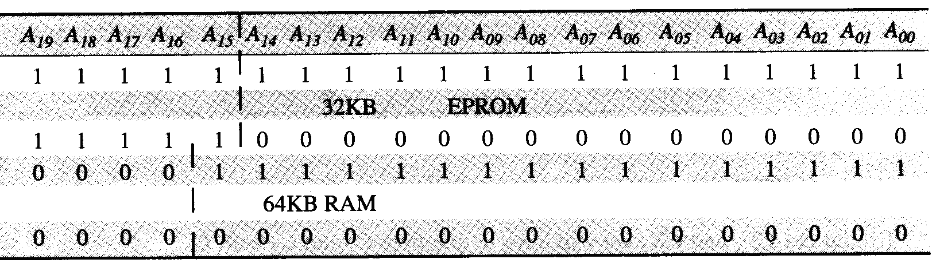
Semiconductor Memory Interfacing
Memory Map Table

Slide 11
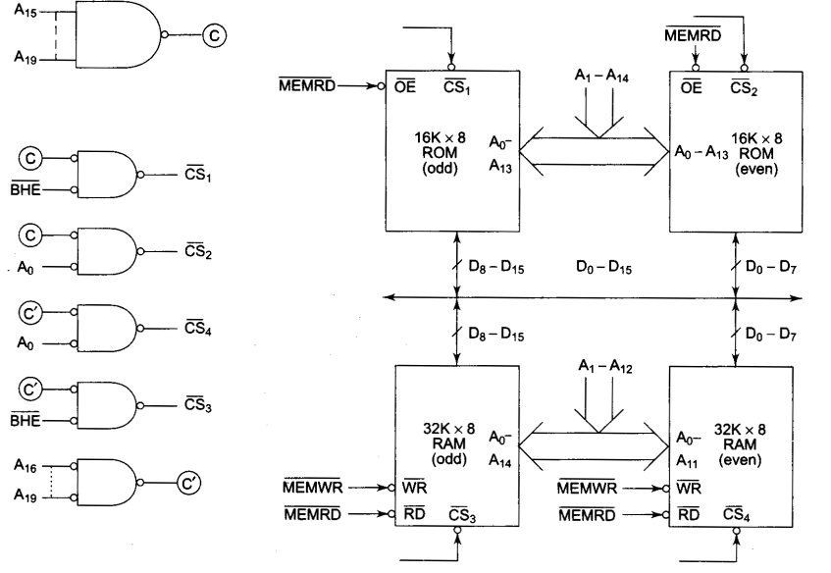
Semiconductor Memory Interfacing
Memory Interfacing

Slide 12
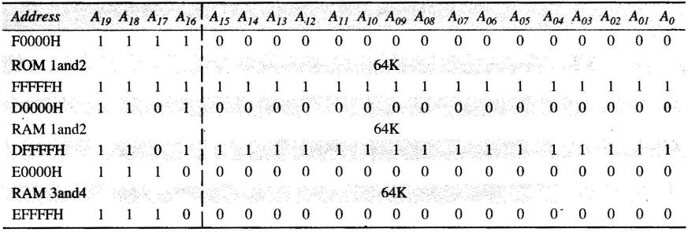
Semiconductor Memory Interfacing
Problem: Interface two chips of 32k X 8 Rom and four chips of 32K X 8 RAM with 8086, according to the following map.
ROM 1 and 2 F0000H – FFFFFH,
RAM 1 and 2 D0000H –DFFFFH and
RAM 3 and 4 E0000H – EFFFFH.
Solutions: Memory map is given below

Slide 13
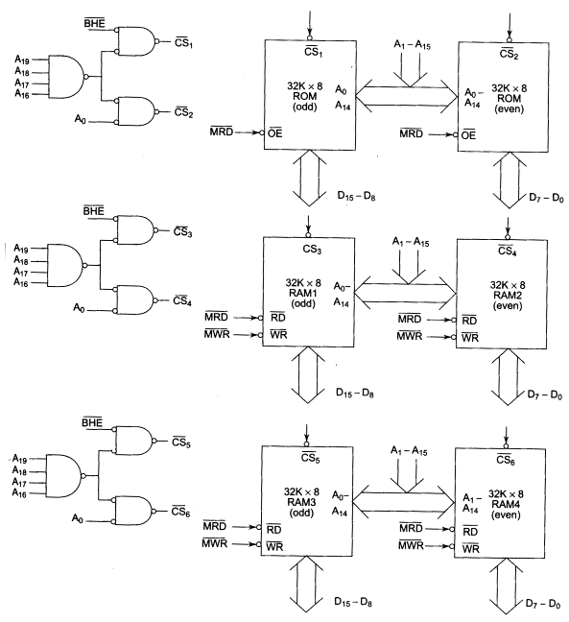
Semiconductor Memory Interfacing

Slide 14
Interfacing Memories With 8088
The techniques of interfacing semiconductor memory with 8088 is exactly like that 0f 8085, the processor 8088 externally has 8 bit data bus just like 8085.
Also the 8088 memory system is not divided even or odd memory banks.
Problem: Design a memory system around 8088, that has total 16 K Bytes EPROM and 32K Bytes RAM. The EPROM chips are available in modules of 8 KB and the RAM chips are available in modules of 8KB. The memory map should be specified below.
EPROM 1 – F0000H – F1FFFH
EPROM 2 – Decides suitably for a practical system.
RAM 1 – contains interrupt vector table
RAM 2 – 30000H – 31FFFH
RAM 3 – 40000H – 41FFFH
RAM 4 – 50000H – 51FFFH

Slide 15
Interfacing Memories With 8088
Solutions: Like 8086, the processor 8088 also starts execution from the address FFFF0H, after reset.
Hence EPROM 2 should be allotted the address space so as to accommodate the locations FFFF0H to FFFFFH, in it.
Thus starting address of EPROM 2 should be FE000H so that the last address is FFFFFH for an 8K X 8 EPROM chip.
The interrupt vector table 0f 8086/88 lies in the zeroth segment of memory system, i.e. RAM 1 must start at 00000H so that the last address is 01FFFFH so as to accommodate interrupt vector table in it.
The available 8 K memory chips has 13 address lines.
Total 20 address lines (A19 – A0) are available from the processor.
The A0 – A12 of the available lines are directly connected to the pins A0 – A12 of the memory chips.
The higher order address lines (A13 – A19) are used for deriving chip selects signal

Slide 16
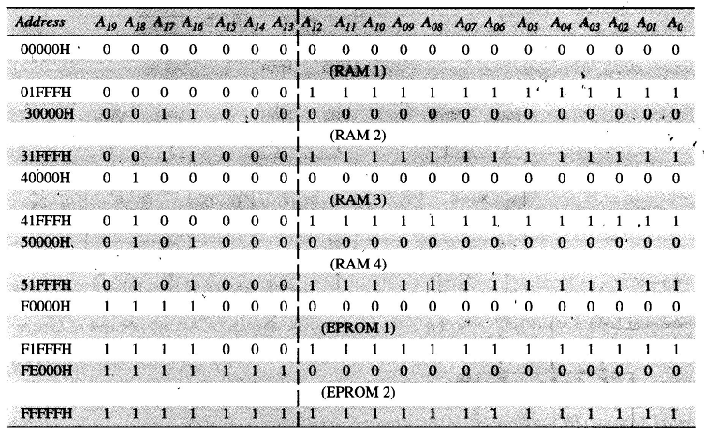
Interfacing Memories With 8088
Memory Map:

Slide 17
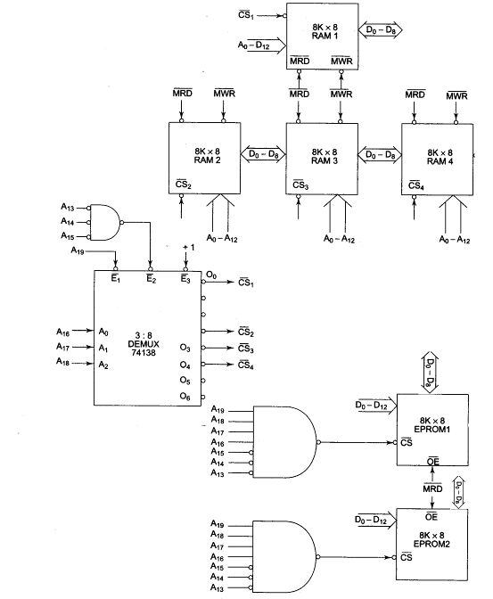
Interfacing Memories With 8088

Slide 18
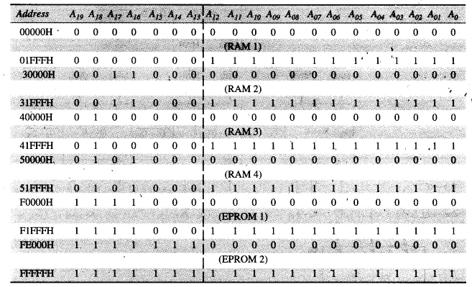
Interfacing Memories With 8088
Problem: Interface a 4K X 8 EPROM, one chip of 8K X 4 ram with 8088. The map should be as given below:
EPROM: FF000H – FFFFFH,
One 8k X 8 RAM: 000000H – 01FFFH and
One 8k X 4 RAM: 050000H – 06FFFH

Slide 19
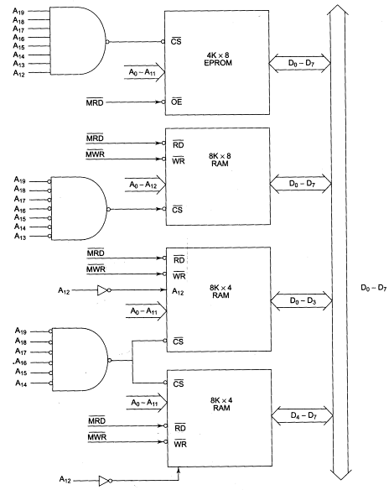
Interfacing Memories With 8088

Slide 20
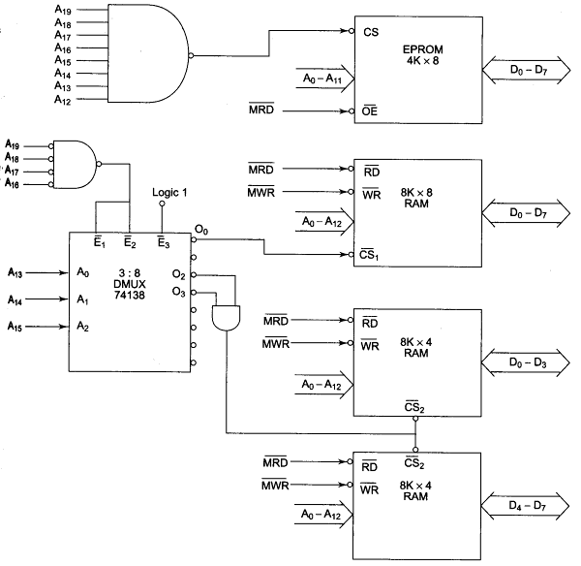
Interfacing Memories With 8088
Alternate Implementation Method

Slide 21
Dynamic RAM Interfacing
Whenever a large memory is required in a micro computer system, the memory subsystem is generally designed using dynamic RAM as it has various advantages e.g. higher packaging density, lower cost and less power consumption.
A typical static RAM cell may require six transistors while the dynamic RAM cell requires only a transistor along with a capacitor,
On the other side, there are some serious drawbacks of dynamic RAMs.
The basic dynamic RAM cell uses a capacitor to store the charge as a representation of data.
This capacitor is manufactured as a diode that is reverse biased so that the storage capacitance comes into picture.
This storage capacitance is utilized for storing the charge representation of data but the reverse – biased diode has a leakage current that tends to discharge the capacitor giving rise to the possibility of data loss.
To avoid this possible data loss, the data stored in a dynamic RAM cell must be refreshed after a fixed time interval regularity.
The process of refreshing the data in the RAM is known as refresh cycle.

Slide 22
Dynamic RAM Interfacing
The refresh cycle is different from the memory read cycle in the following aspects.
The memory address is not provided by the CPU address bus, rather, it is generated by a refresh mechanism counter known as refresh counter.
Unlike memory read cycle, more than one memory chip may be enabled at a time so as to reduce the number of total memory cycles.
The data enable control of the selected memory chip is deactivated , and the data is not allowed to appear on the system data buss during refresh, as more than one memory units are refreshed simultaneously.
This is to avoid the data from different chips to appear on the bus simultaneously.
Memory read is either a processor initiated or an external bus master initiated operation while memory refresh is an independent regular activity, initiated and carried out by the refresh mechanism.

Slide 23
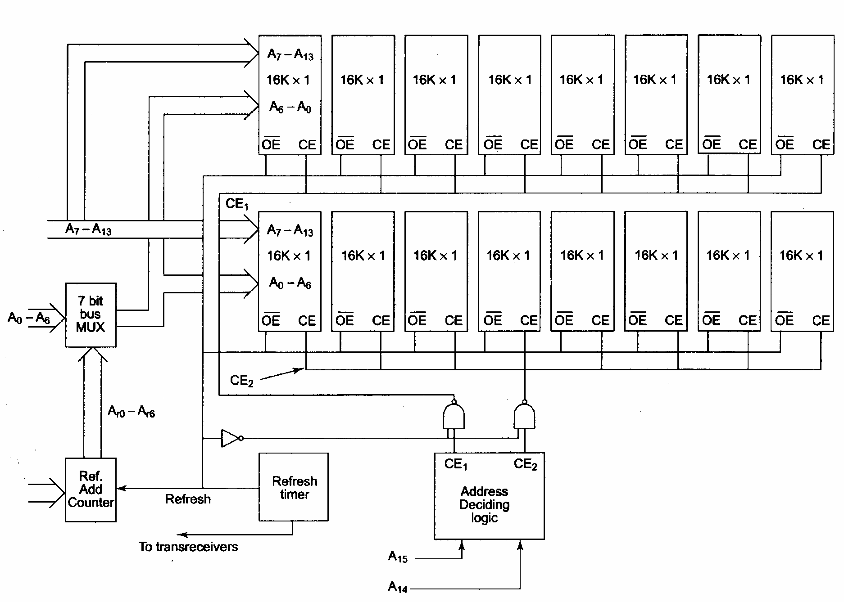
Dynamic RAM Interfacing
Refreshing logic and 8086 interface with dynamic RAM each of the used chips
is a 16 K X 1 –bit dynamic RAM cell array.

Slide 24
Dynamic RAM and Dynamic RAM Controller
Dynamic RAM controllers are used to perform the refresh cycles.
The pin assignments for 2164 dynamic RAM chip are shown.
The RAS (bar) and CAS (bar) are row and column address strobes and are driven by dynamic RAM controller outputs.
A0 – A7 lines are the row or column address lines, driven by OUT 0 –OUT 7 outputs of the controller.
The WE (bar) pin indicates memory write cycles.
The Din and Dout pins are data pins for write and read operations, respectively.
In practical circuits, the refreshing logic is integrated inside dynamic RAM controller chips like 8203, 8202 and 8207, etc.

Slide 25
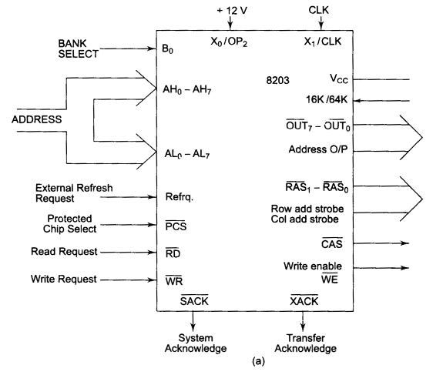
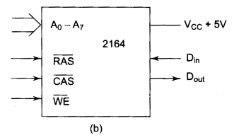
Dynamic RAM and Dynamic RAM Controller
Dynamic RAM Controller
Dynamic RAM

Slide 26
Dynamic RAM and Dynamic RAM Controller
Intel’s 8203 is a dynamic RAM controller that supports 16 K or 64 K dynamic RAM chips.
The address inputs of 8203 controller accept address lines A1 to A16 on the lines AL0- AL7 and AH0 – AH7.
The RD (bar) and WR (bar) signals decode whether the cycle is a memory read or memory write cycle and accepted as inputs to 8203 from the microprocessor.
The WE (bar) signal specifies the memory write cycle and is an output from 8203 that drives the WE (bar) input of dynamic RAM memory chip.

Slide 27
Dynamic RAM and Dynamic RAM Controller
The OUT0 (bar) - OUT 7 (bar) set of 8 pins is an 8 bit output bus that carries multiplexed row and column addresses of a bit location in dynamic RAM memory chip.
The CAS (bar) signal strobes the column address on OUT0 (bar) – OUT7 (bar).
The RAS1 (bar) – RAS0 (bar) pins strobes row address on OUT0 (bar)- OUT 7 (bar) for at the most two banks of 2164 dynamic RAM chips.
An external crystal may be applied between X0 – X1 pins, otherwise, with the OP2 pin at +12V, a clock signal may be applied at the pin CLK.
The PCS bar pin accepts the chip select signal derived by an address decoder.
The REFREQ pin is used whenever the memory refresh cycle is to be initiated by an external signal.
The XACK bar signal indicates that the data available during a read cycle or it has been written if it is a write cycle.
The SACK bar output signal marks the beginning of a memory cycle.

Slide 28
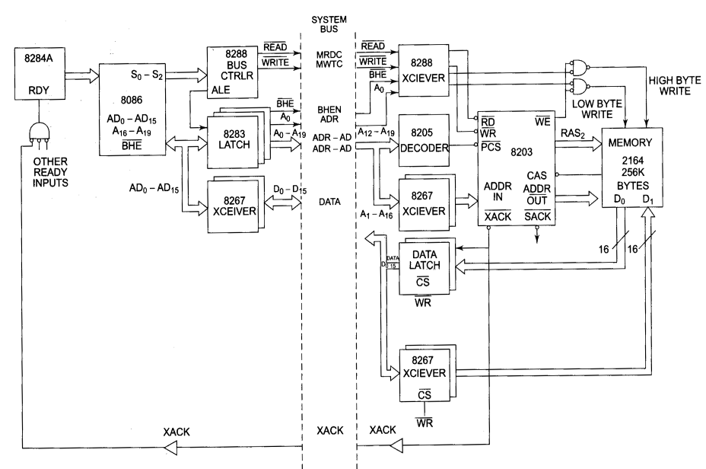
Interfacing 2164 using 8203

Slide 29
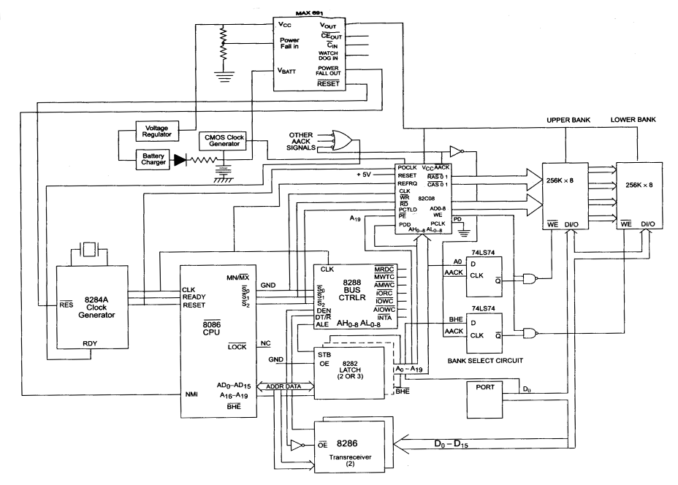
Interfacing 512KB DRAM with 8086

Slide 30
Interfacing I/O Ports
I/O ports or input/output ports are the devices through which the microprocessor communicates with other devices or external data sources/ destinations.
Input activity enables the microprocessor to read data from external devices,
For example keyboards, joysticks, mouse, etc. these devices are known as input devices as they feed data in to a microprocessor system.
Output activity transfers data from the microprocessor to the external devices,
for example CRT display, 7 –segment displays, printers, etc. the devices which are accept data from a microprocessor system are called output devices.
Thus for a microprocessor the input activity similar to read operation.
While the output activity similar to write operation.
Note that an input device can only be read and an output device can only be written.
Hence IORD (bar) operation is related with reading data from an input device and not an output device and IOWR (bar) operation means writing data to an output device and not an input device.

Slide 31
Interfacing I/O Ports
Steps in interfacing an I/O Device.
The following steps are performed to interface a general I/O device with a CPU.
Connect the data bus of the microprocessor system with the data bus of the I/O port.
Derive a device address pulse by decoding pulse by decoding the required address of the device and use it as the chip select of the device.
Use a suitable control signal, i.e. IORD (bar) and/or IOWR (bar) to carry out device operations, i.e. connect IORD (bar) to RD (bar) input of the device if it is an input device, otherwise connect IOWR (bar) to WR (bar) input of the device.

Slide 32
Interfacing I/O Ports
Methods of interfacing I/O devices:
There are two methods of interfacing general I/O devices
I/O mapped and
Memory mapped.
In I/O mapped interfacings the devices are viewed as distinct I/O devices and are addressed accordingly.
While in memory mapped – scheme, the devices are viewed as memory locations and addressed likewise.
The I/O mapped scheme may be used at most 16 address lines A0 – A15 or even 8 address lines for the address decoding.
Thus unused higher order address lines are logic zero, while addressing the device.
An I/O mapped device requires the use of IN and OUT instructions for accessing them.
In case of 8086, a maximum of 64 K input and 64 K byte output devices or 32k input and 32K word devices can be interfaced.
The IOWR (bar) and IORD (bar) signals are used for I/O mapped interfacing.

Slide 33
Interfacing I/O Ports
In case of the 8086 systems, the memory – mapped method is seldom used.
Hence all the peripheral devices in most of the practical systems are essentially I/O mapped devices.
8086 has a 16 bit data bus, hence interfacing of 8 bit devices with 8086 need special consideration.
Usually, 8 bit I/O devices are interfaced with lower order data bus of 8086, i.e. D0 – D7.
The 16 bit devices are interfaced directly with the 16 bit data bus, using A0 and BHE bar pins of 8086.

Slide 34
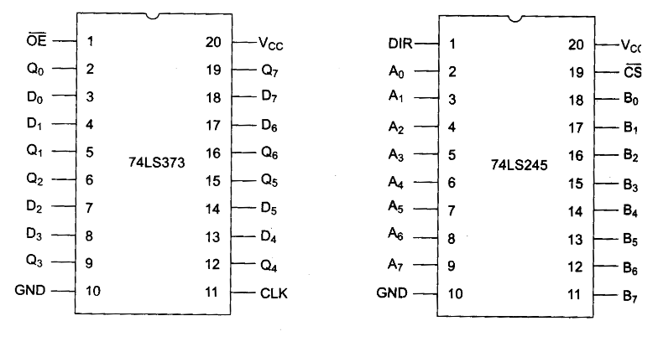
Interfacing I/O Ports
For interfacing output ports generally Latches are used while for input ports, buffers are used.
Most typically used latch and buffer are 74373 and 74245.

Slide 35
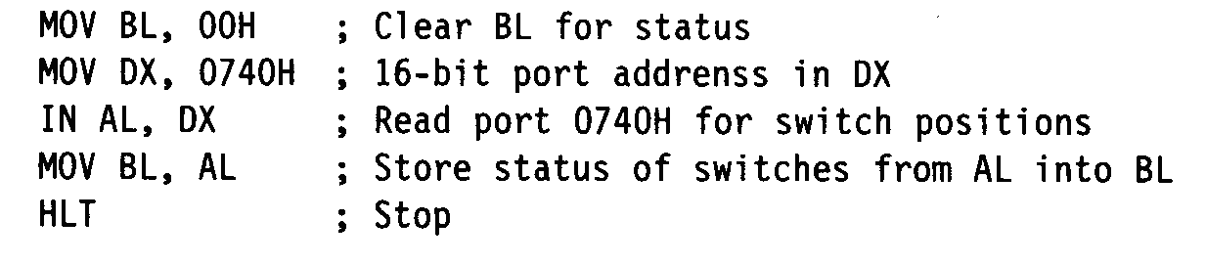
Interfacing I/O Ports
Problem: Interface an input port 74LS245 to read the status of switches SW1 to SW8. The switches, when shorted, input a ‘1’ else input a ‘0’ to the microprocessor system. Store the status in register BL. The address of the port is 0740H.
ALP for above problem is:-

Slide 36
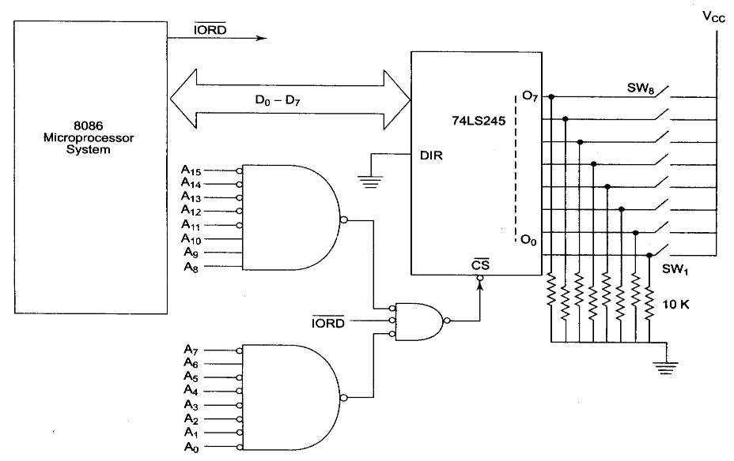
Interfacing I/O Ports

Slide 37
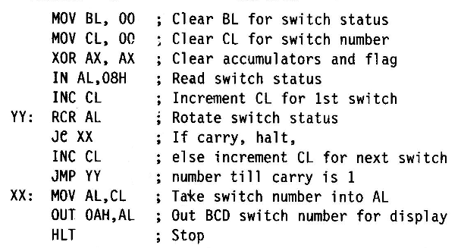
Interfacing I/O Ports
Problem: Design an interface of an input port 74LS245 to read the status of switches SW1 to SW8 (as in the previous problem), and an output port 74LS373 with 8086. Display the number of a key that is pressed, i.e. from 1 to 8 on a 7 – segment display with help of the output port. Write an ALP for this task, assume that only one key is pressed at a time. Draw the schematic of the required hardware. The input port address is 0008H and the output address is 0000AH.

Slide 38
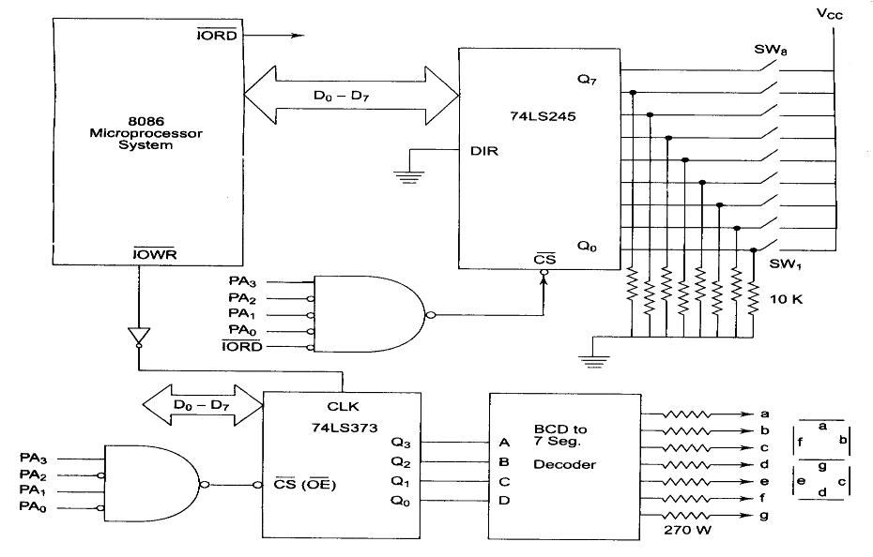
Interfacing I/O Ports

Slide 39
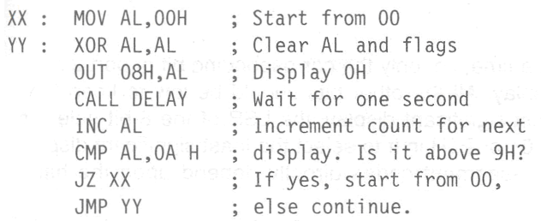
Interfacing I/O Ports
Problem: Using 74LS373 output ports and 7 –segment displays, design a seconds counter that counts from 0 to 9. Draw the suitable hardware schematic and write an ALP for this solution. Assume that a delay of 1 sec is available as a subroutine. Select the port address suitably.

Slide 40
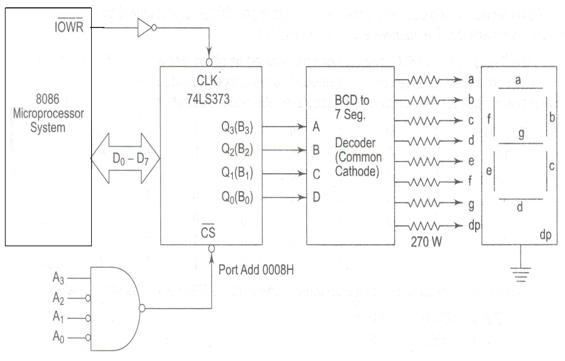
Interfacing I/O Ports

Slide 41
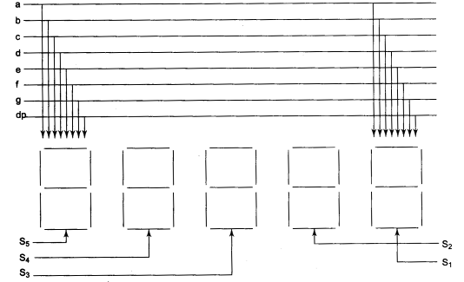
Interfacing I/O Ports
Problem: Draw a schematic hardware circuit for interfacing five, 7 – segment displays (common cathode) with 8086 using output ports. Displays numbers 1 to 5 on them continuously. The 7 – segment codes are stored in a look up table serially at the address 2000:0000 H onwards starting from code for 1.

Slide 42
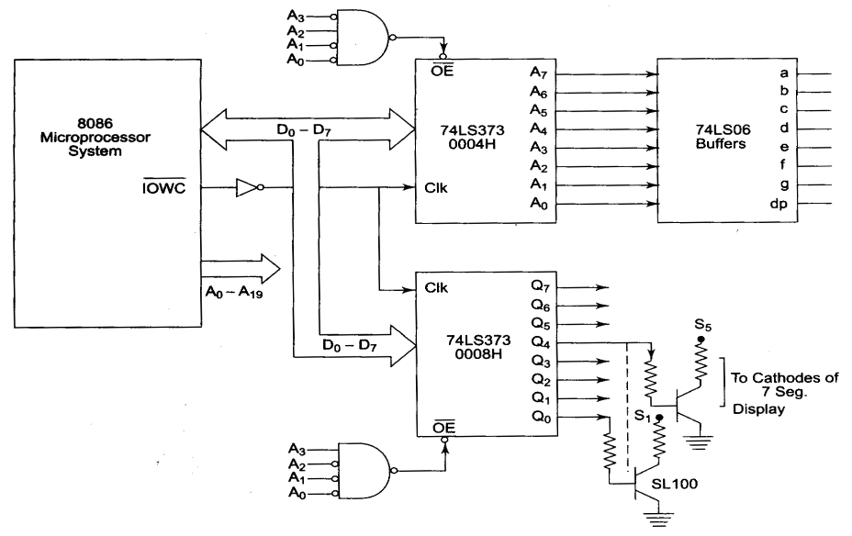
Interfacing I/O Ports

Slide 43
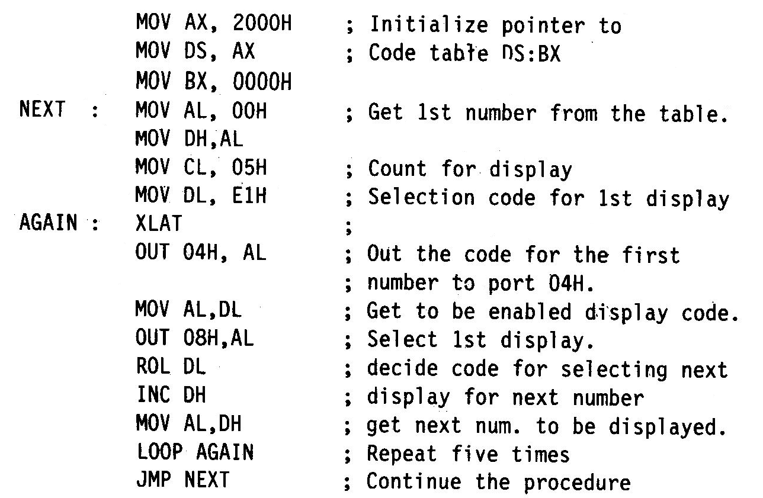
Interfacing I/O Ports

Slide 44
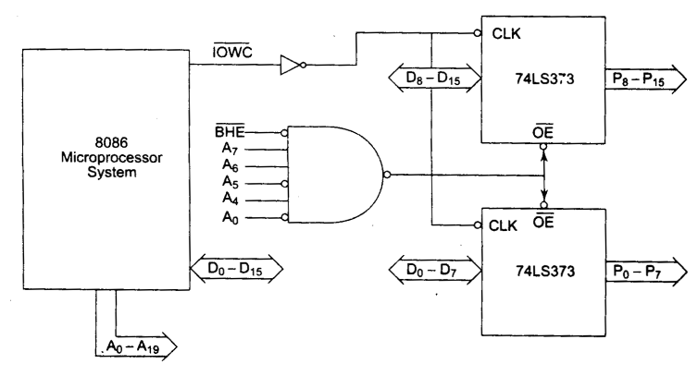
Interfacing I/O Ports
For interfacing of 16-bit output port we have:-

Slide 45
PIO 8255: Programmable Input- Output Port
The parallel input – output port chip 8255 is also known as programmable peripheral input – output port.
The Intel’s8255 is designed for use with Intel’s 8 bit, 16 bit and higher capability microprocessors.
It has 24 input/ output lines which may be individually programmed in two groups of twelve lines each, or three groups of 8 lines.
The two groups of I/O pins named as Group A and Group B each of these two groups contain a subgroup of eight I/O lines called 8 bit port and another sub group of four I/O lines or a 4 bit port.
Thus Group A contains an 8 bit port A along with a 4 bit port, C upper.
The port A lines are identified by symbols PA0 – PA7 while the port C lines are identified as PC4 – PC7.
Similarly Group B contains an 8 bit port B, containing lines PB0- PB7 and a 4 bit port C with lower bits PC0 –PC3.
The port C upper and port C lower can be used in combination as an 8 bit port C.

Slide 46
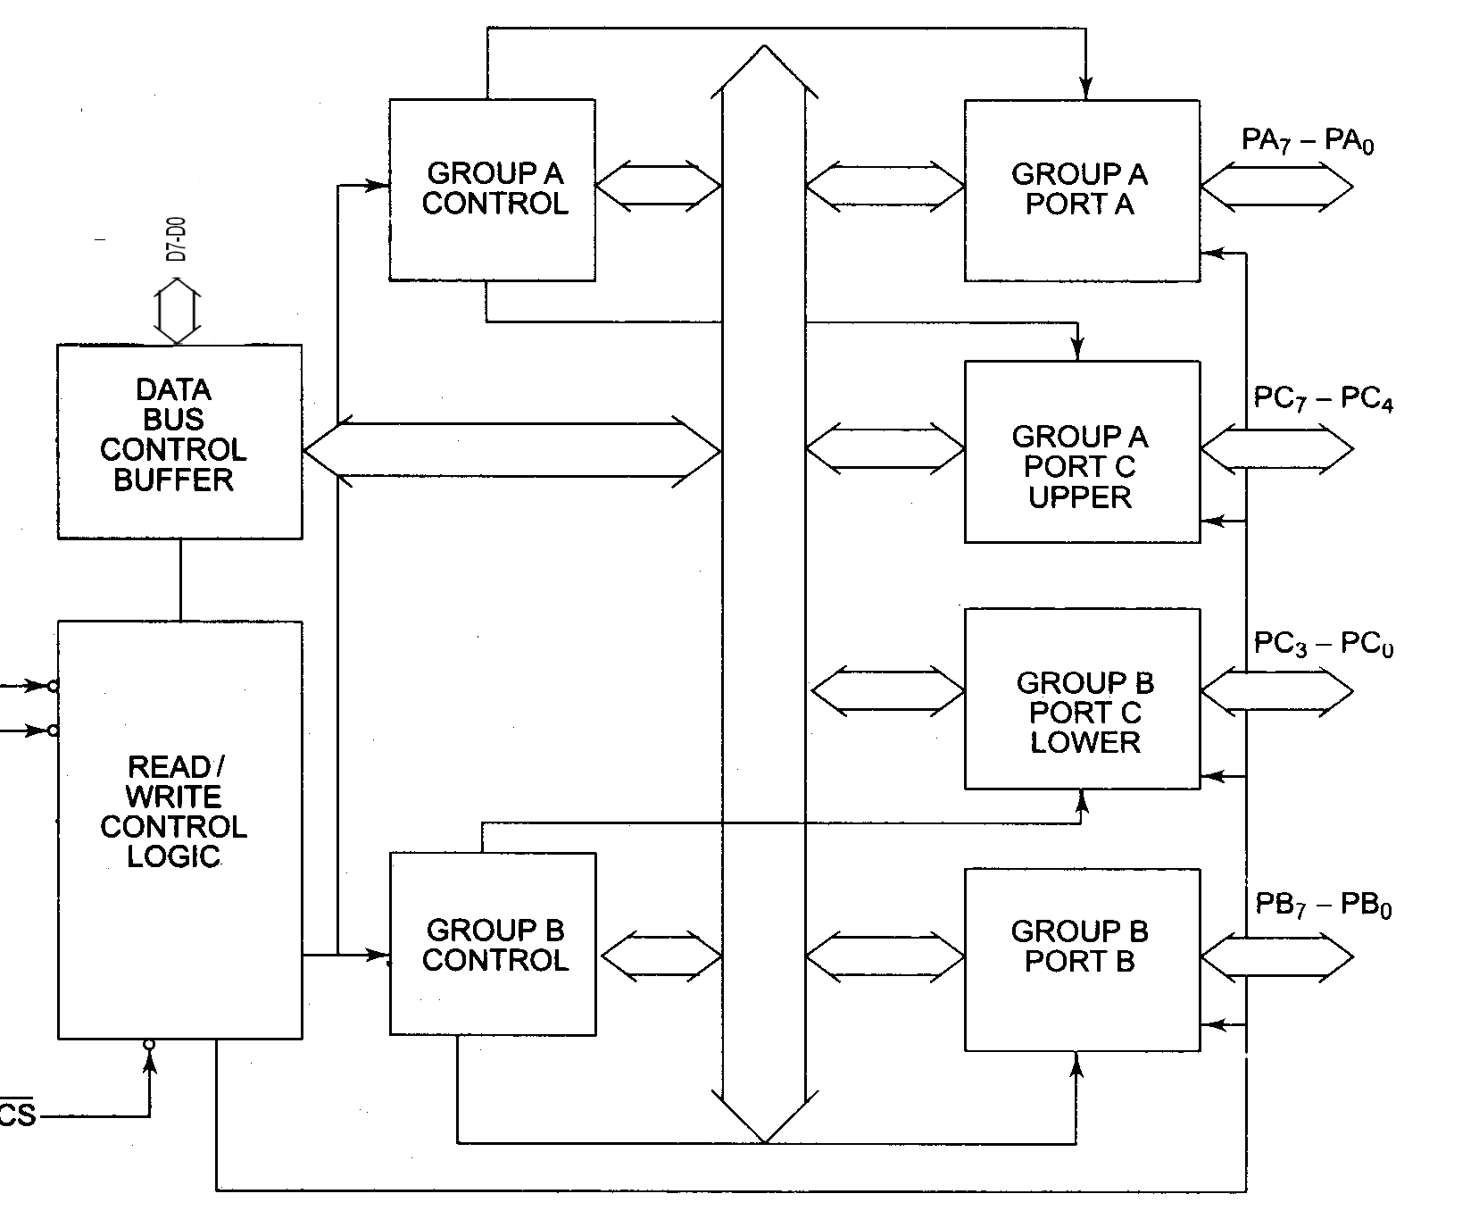
8255 Internal Block Diagram

Slide 47
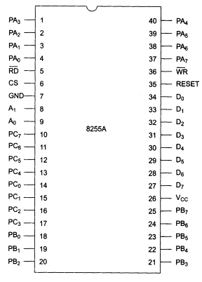
8255 Pin Configuration

Slide 48
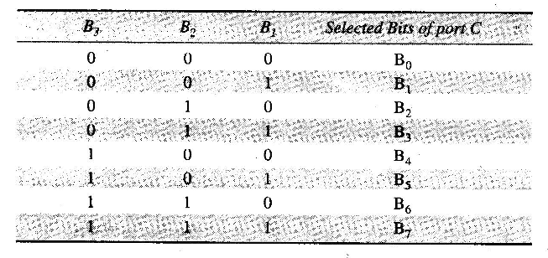
8255 Modes of Operation
BSR MODE
In this mode, any of the 8 bits of port C can be set or reset depending on B0 of the control word.
The bit to be set or reset is selected by bit selected by bit select flags B3, B2 and B1 of the CWR as given in Table

Slide 49
8255 Modes of Operation
I/O MODES
MODE 0 (Basic I/O mode)
This mode also known as basic input/ output mode.
This mode provides simple input and output capability using each of the three ports.
Two 8 bit ports (port A and port B) and two 4 bit ports (port C upper and lower) are available.
Any port can be used as input or output port.
Output ports are latched. Input ports are not latched
A maximum of four ports available so that overall 16 I/O configurations are possible.
All these modes can be selected by programming a register internal to 8255, known as control word register (CWR) which has two formats.

Slide 50
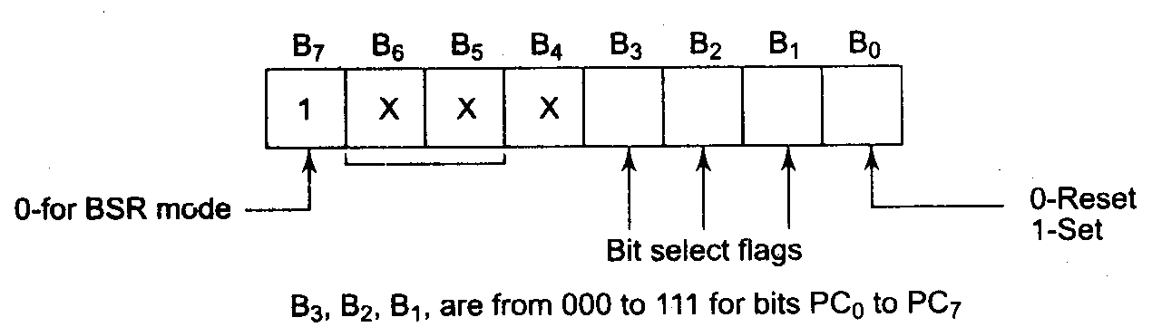
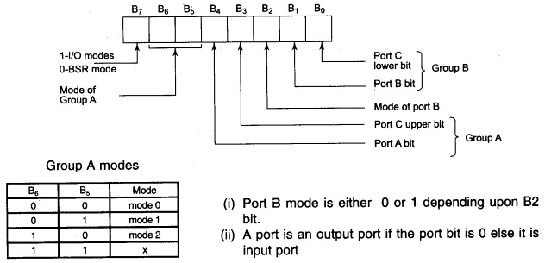
8255 Modes of Operation
BSR Mode CWR Format:
I/O Mode CWR Format:

Slide 51
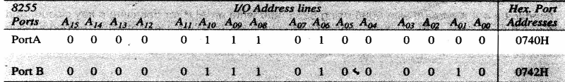
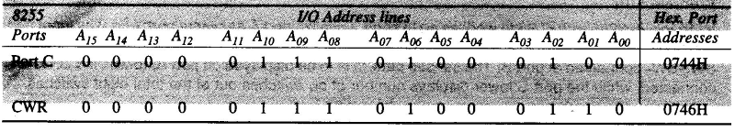
8255 Modes of Operation
Problem: Interface an 8255 with 8086 to work as an I/O port. Initialize port A as output port, port B as an input port and port C as output port. Port A address should be 0740 H. write a program to sense switch positions SW0 – SW7 connected at port B. the sensed pattern is to be displayed on port A, to which 8 LEDS are connected, while the PORT C lower displays number of on switches out of the total 8 switches.

Slide 52
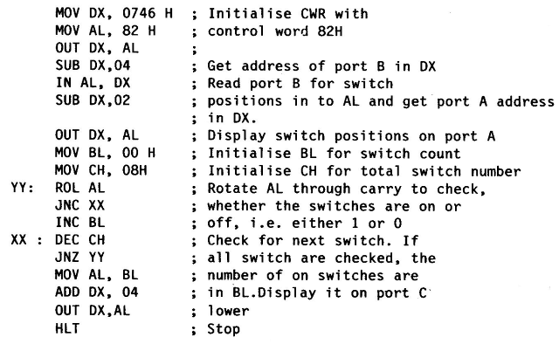
8255 Modes of Operation
ALP for above problem:

Slide 53
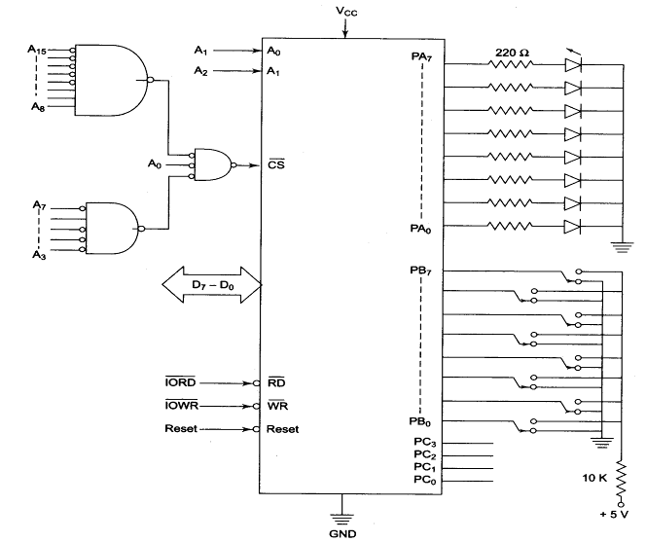
8255 Modes of Operation
8255 Interfacing with 8086

Slide 54
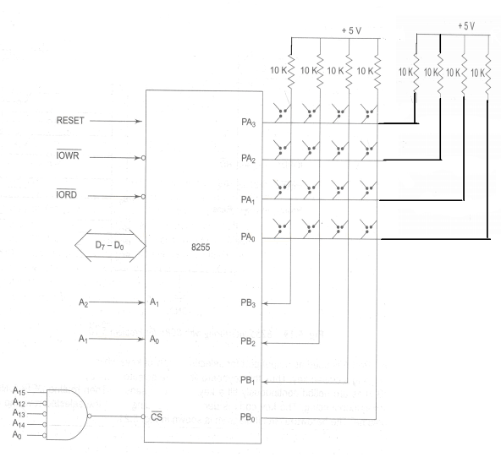
8255 Modes of Operation
Problems: Interface a 4*4 keyboard with 8086 using 8255.

Slide 55
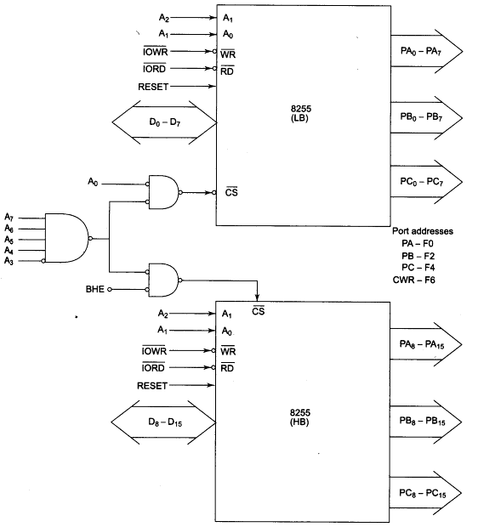
8255 Modes of Operation
Interface 16 – bit 8255 ports with 8086/ the address of port A is F0H.

Slide 56
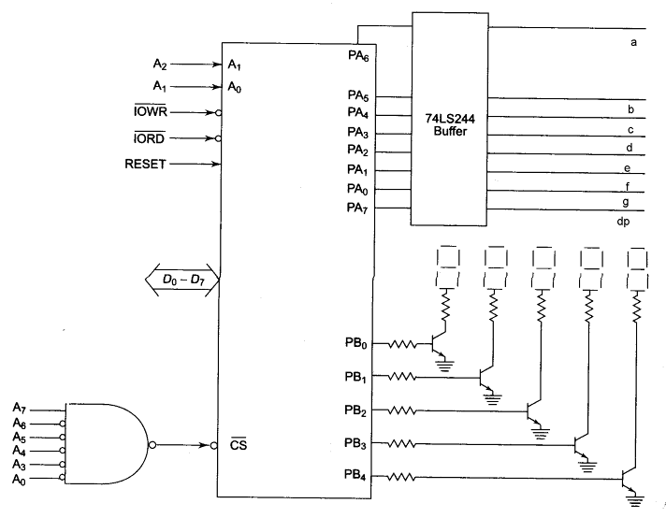
8255 Modes of Operation
Interface an 8255 with 8086 at 80H as an I/O address of port A, interface five 7 segment displays with the 8255.

Slide 57
8255 Modes of Operation
MODE 1(Strobed I/O mode)
This mode is also called as strobed input/output mode.
The salient features of mode 1 are listed as follows.
Two groups – group A and group B are available for strobed data transfer.
Each group contains one 8 bit data I/O port and 4 bit control/data port.
The 8 bit data port can be either used as input or an output port. Both the inputs and outputs are latched.
Out of 8 bit port C, PC0 – PC2 are used to generate control signals for port port B and PC3 – PC5 are used to generate control signals for [port A. the lines PC6, PC7 may be used as independent data lines.
The control signal for both the groups in input and output modes are explained as follows

Slide 58
8255 Modes of Operation
Input control signal definitions (mode 1)
STB BAR (Strobe input) – if this line falls to logic low level, the data available at 8 input port is loaded into input latches.
IBF (input buffer full) – if this signal rises to logic 1, it indicates that the data has been loaded into the latches, i.e. it works as an acknowledgement. IBF is set by a low on STB and reset by rising edge of RD input.
INTR (Interrupt request) – this active high output signal can be used to interrupt the CPU whenever an input device request the service. INTR is set by a high at STB pin and high at IBF pin.
OBF (Output buffer null) – this status signal, whenever falls to logic low, indicates that the CPU has written data to the specified output port.
ACK BAR (Acknowledge input) - ACK BAR signal acts as an acknowledgement to be given by an output device. ACK signal, whenever low, informs the CPU that the data transferred by the CPU to the output device through the port is received by the output device.
INTR (Interrupt request) - Thus an output signal that can be used to interrupt the CPU when an output device acknowledges the data received from the CPU. INTR is set when ACK, OBF and INTE are ‘1’. It is reset by a falling edge on WR input.

Slide 59
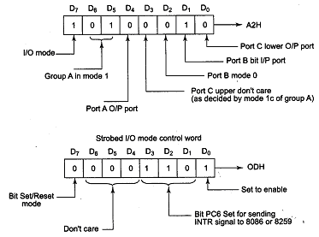
8255 Modes of Operation
Interface standard IEEE – 488 parallel bus printer with 8086. Draw the necessary hardware scheme required for the same and write an ALP to print a character whose ASCII code is available in AL.
Readers are requested to get more details of the IEEE – 488 bus.

Slide 60
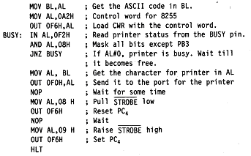
8255 Modes of Operation
ALP for printing characters

Slide 61
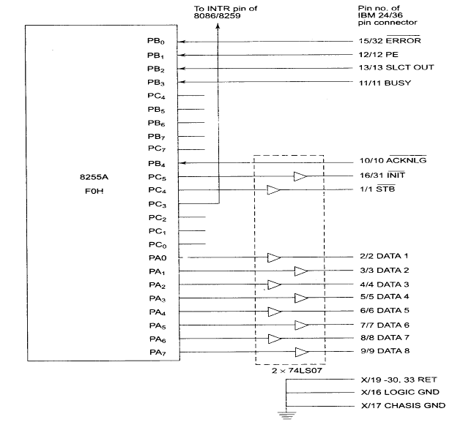
8255 Modes of Operation

Slide 62
8255 Modes of Operation
MODE 2 (Strobed bidirectional I/O)
This mode of operation of 8255 is also known as strobed bidirectional I/O.
The salient features of mode 2 of 8255 are listed as follows
The single 8 – bit port in group A is available
The 8 – bit port is bidirectional and additionally a 5 – bit control port is available
Three I/O lines are available at port C, viz. PC2 – PC0
Inputs and outputs are both latched
The 5 – bit control port C (PC3 – PC7) is used for generating/ accepting handshake signals for the 8 bit data transfer on port A.
Control Signals in mode 2:
INTR (Interrupt request) - As in mode 1, this control signal is active high and is used to interrupt the microprocessor to ask for the transfer of the next data by to / from it. The signal is used for input (read) as well as output (write) operations.

Slide 63
8255 Modes of Operation
Control signals for output operations
OBF BAR (Output buffer full) this signal, when falls to logic low level, indicates that the CPU written data to port A.
ACK BAR (Acknowledge) this control input, when falls to logic low level, acknowledges that the previous data byte is received by the destination and the next byte may be sent by the processor. This signal enables the internal tristate buffers to send out the next data byte on port A.
INTE 1 (A flag associated with OBF BAR) This can be controlled by bit set / reset mode with PC6.
Control signals for input operations
STB BAR (Strobe input) – A low on this line is used to strobe in the data into the input latches of 8255.
IBF (Input buffer full) – When the data is loaded to in to the input buffer, this signal rises to logic ‘1’. This can be used as an acknowledgement that the data has been received by the receiver.
The INTR goes high only if either IBF, INTE 2, STB bar and RD bar go high or OBF bar, INTE1, ACK bar and WR bar go high. The port C can be read to know the status of the peripheral device, in terms of the control signals, using the normal I/O instructions.

Slide 64
8255 Modes of Operation
An 8086 system with a 8255 interfaced at port A address F0H, has a block of 100 data bytes stored in it. Another 8086 system with another 8255 interfaced at port A address 80H has another block of 100 data bytes stored in it. Interchange these blocks of data bytes between the 8086 systems. Draw the necessary hardware scheme and write the necessary sequence instructions. Both systems run on the same CLK rate.

Slide 65
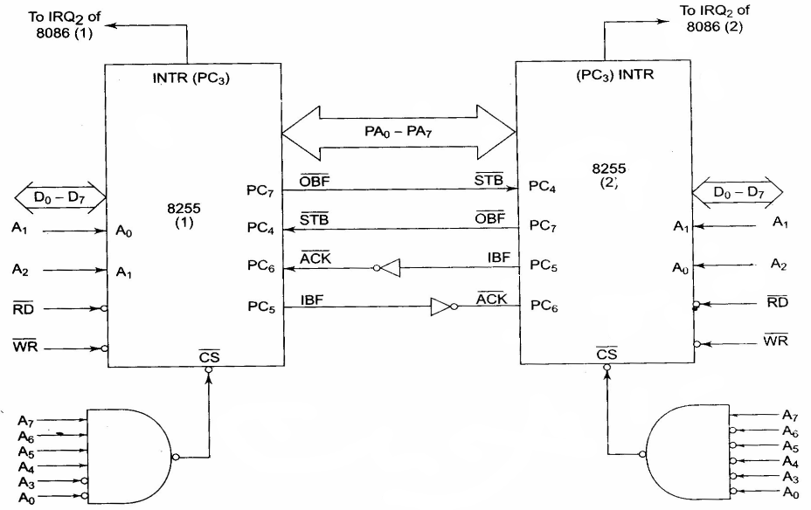
8255 Modes of Operation

Slide 66
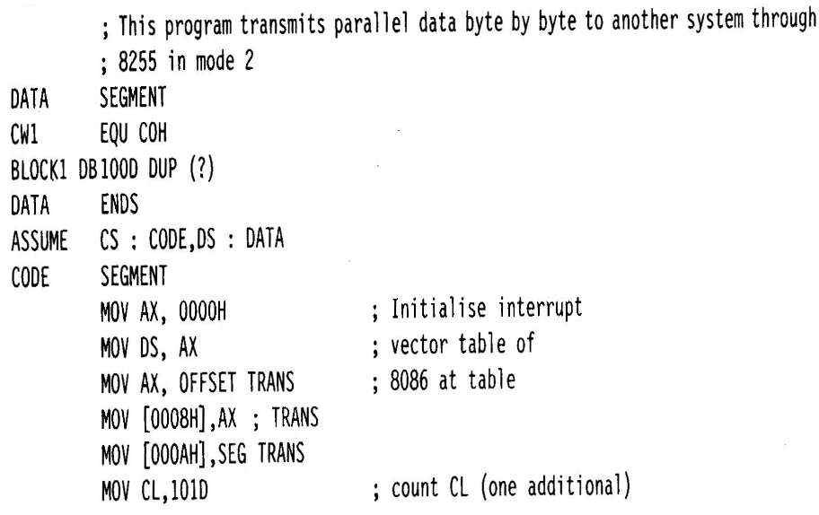
8255 Modes of Operation
Transmitter ALP:

Slide 67
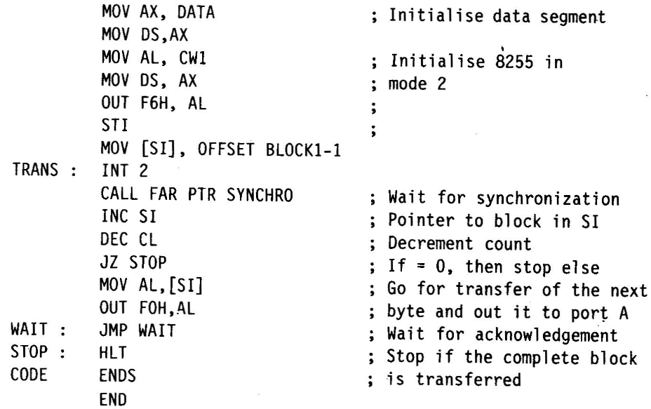
8255 Modes of Operation

Slide 68
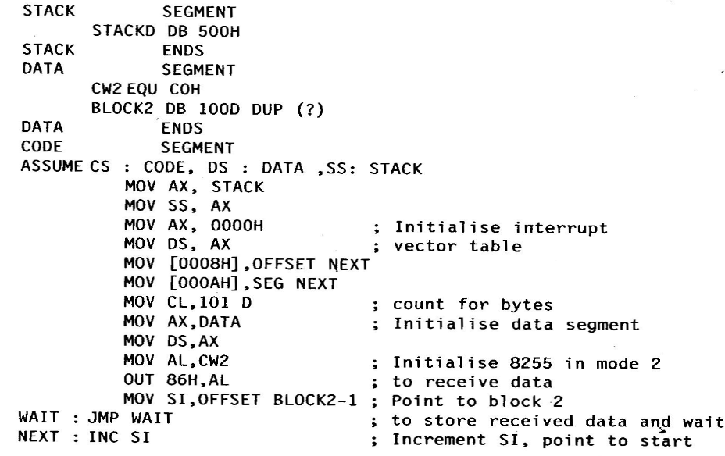
8255 Modes of Operation
Receiver ALP:

Slide 69
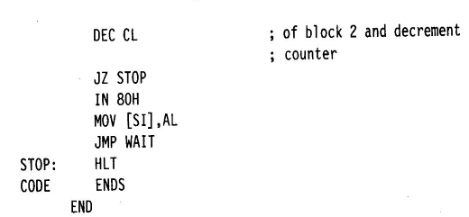
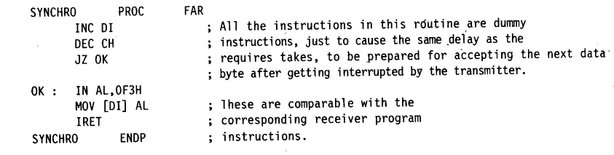
8255 Modes of Operation
ALP for Synchronous Delay:

